Slide 1
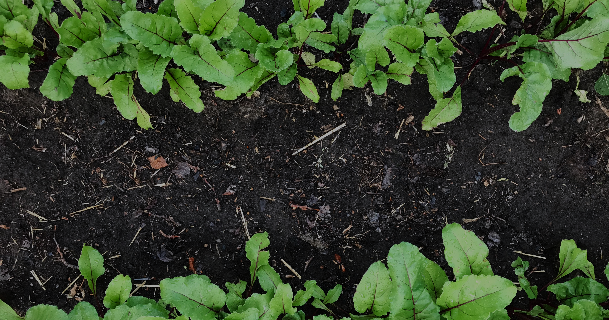
Great Green

Slide 2
Team Members
Bhargav Chickmagalur Nanjundappa
Hitesh Krishnappa
Fred Amartey

Slide 3



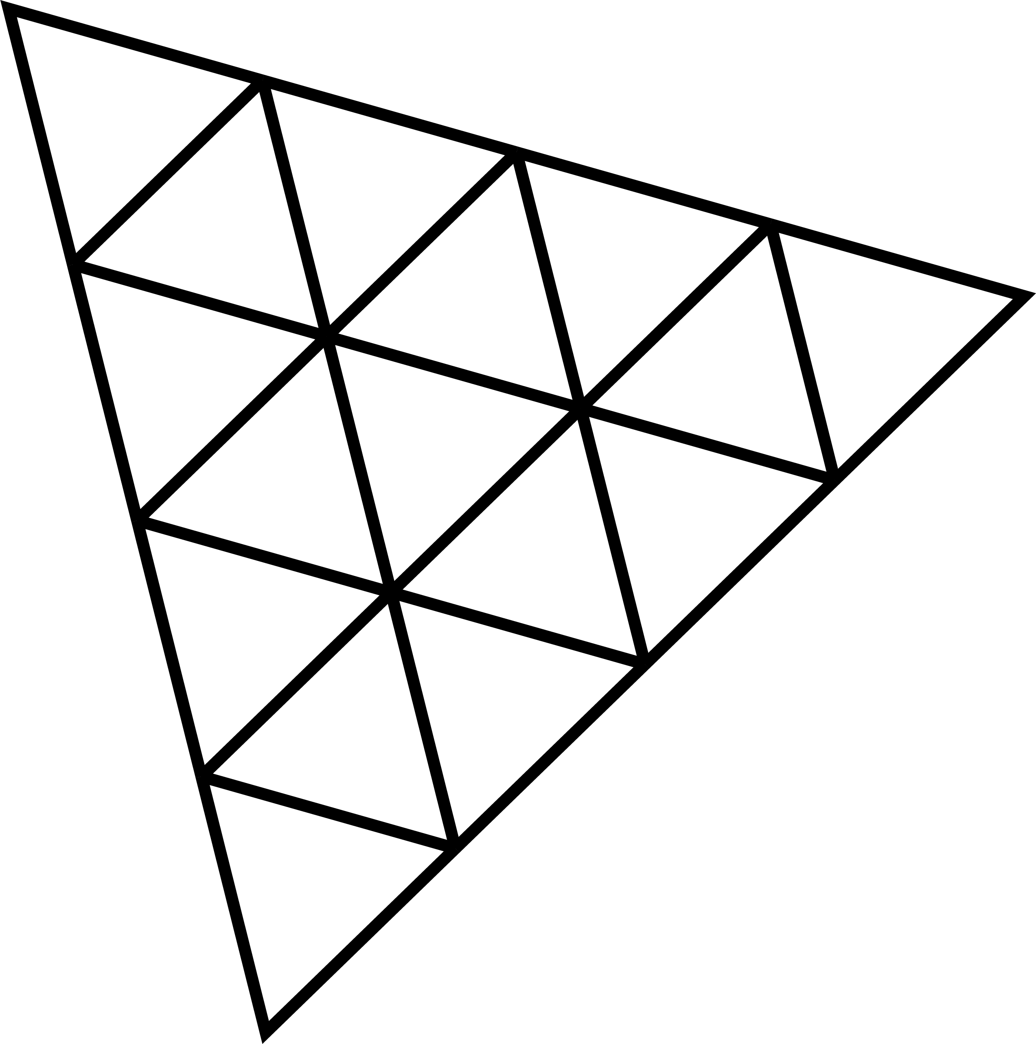
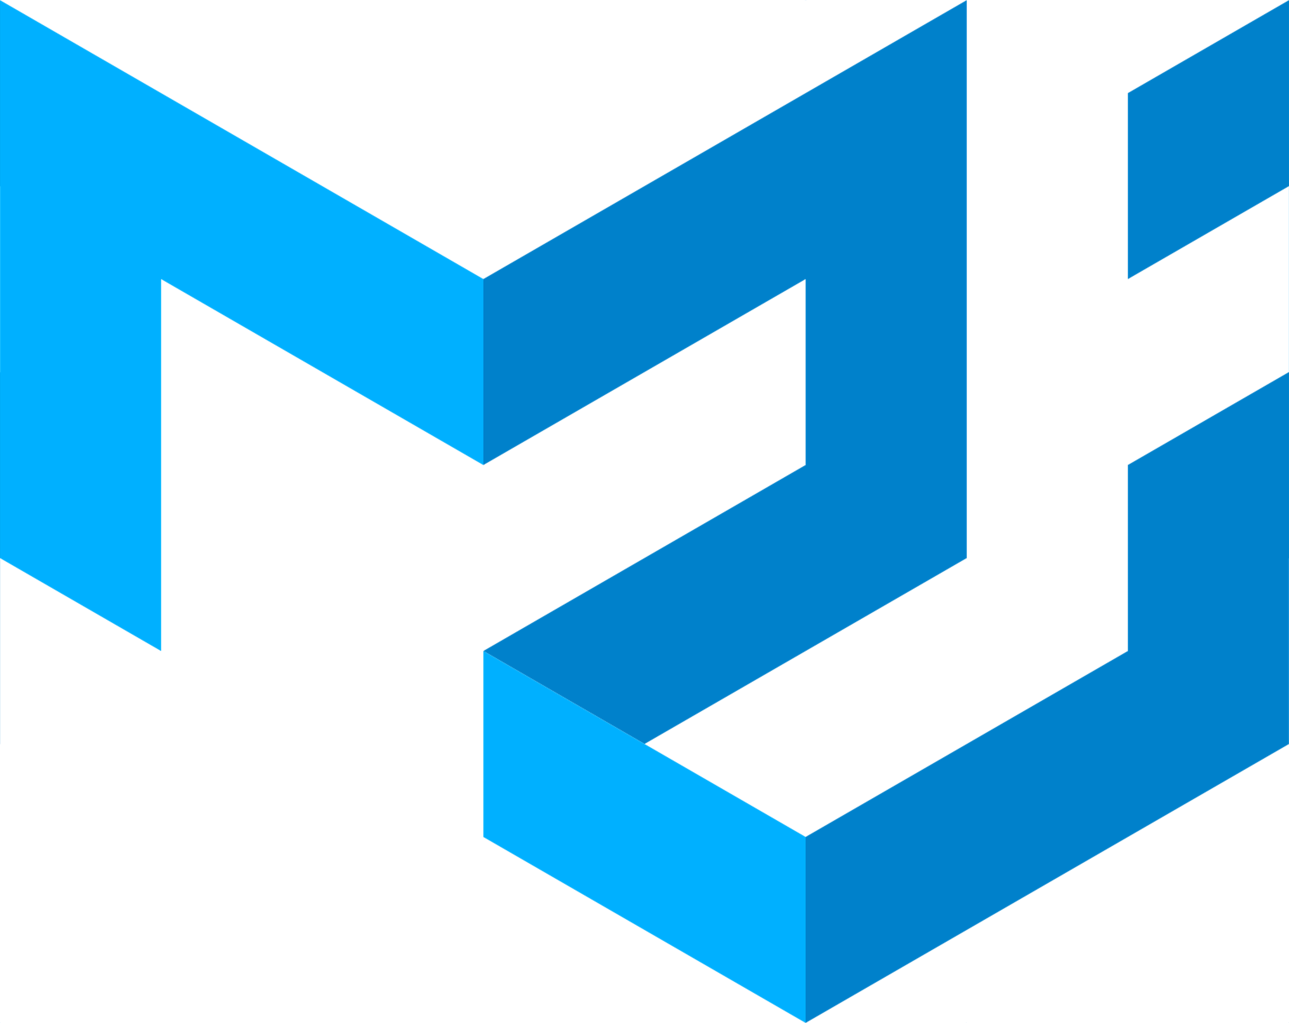






Tech Stack

Slide 4
Project Description
Great-Green is a pioneering web application designed to address the critical challenges of desertification, particularly in desert belts like the Sahel, through innovative reforestation and sustainable land management efforts.

Slide 5
What's the problem?
The UN has been combating desertification in the Sahara since 2007.
The Sahara has been encroaching the Sahel region rapidly at a rate of 10% over the last 100 years. This desertification affects the inhabitants of the Sahel region causing dry lands and effectively infertile soil over time.
The Sahel region is receiving far less rainfall than it did during the first half 20th century.
The bio-diversity within the region is depreciating year after year.
The effects of climate change are very apparent in the region.

Slide 6
Our solution
The best way to combat this is proactive afforestation in the Sahel region while encouraging bio-diversity.
The UN launched the GreatGreenWall Initiative in 2007 but the project hasn't seen any significant advances in years.
We came up with Great Green - an application designed to engage the community and make getting involved easier to facilitate the progress of the GreatGreenWall Initiative.
This is what our application Great Green aims to solve.

Slide 7
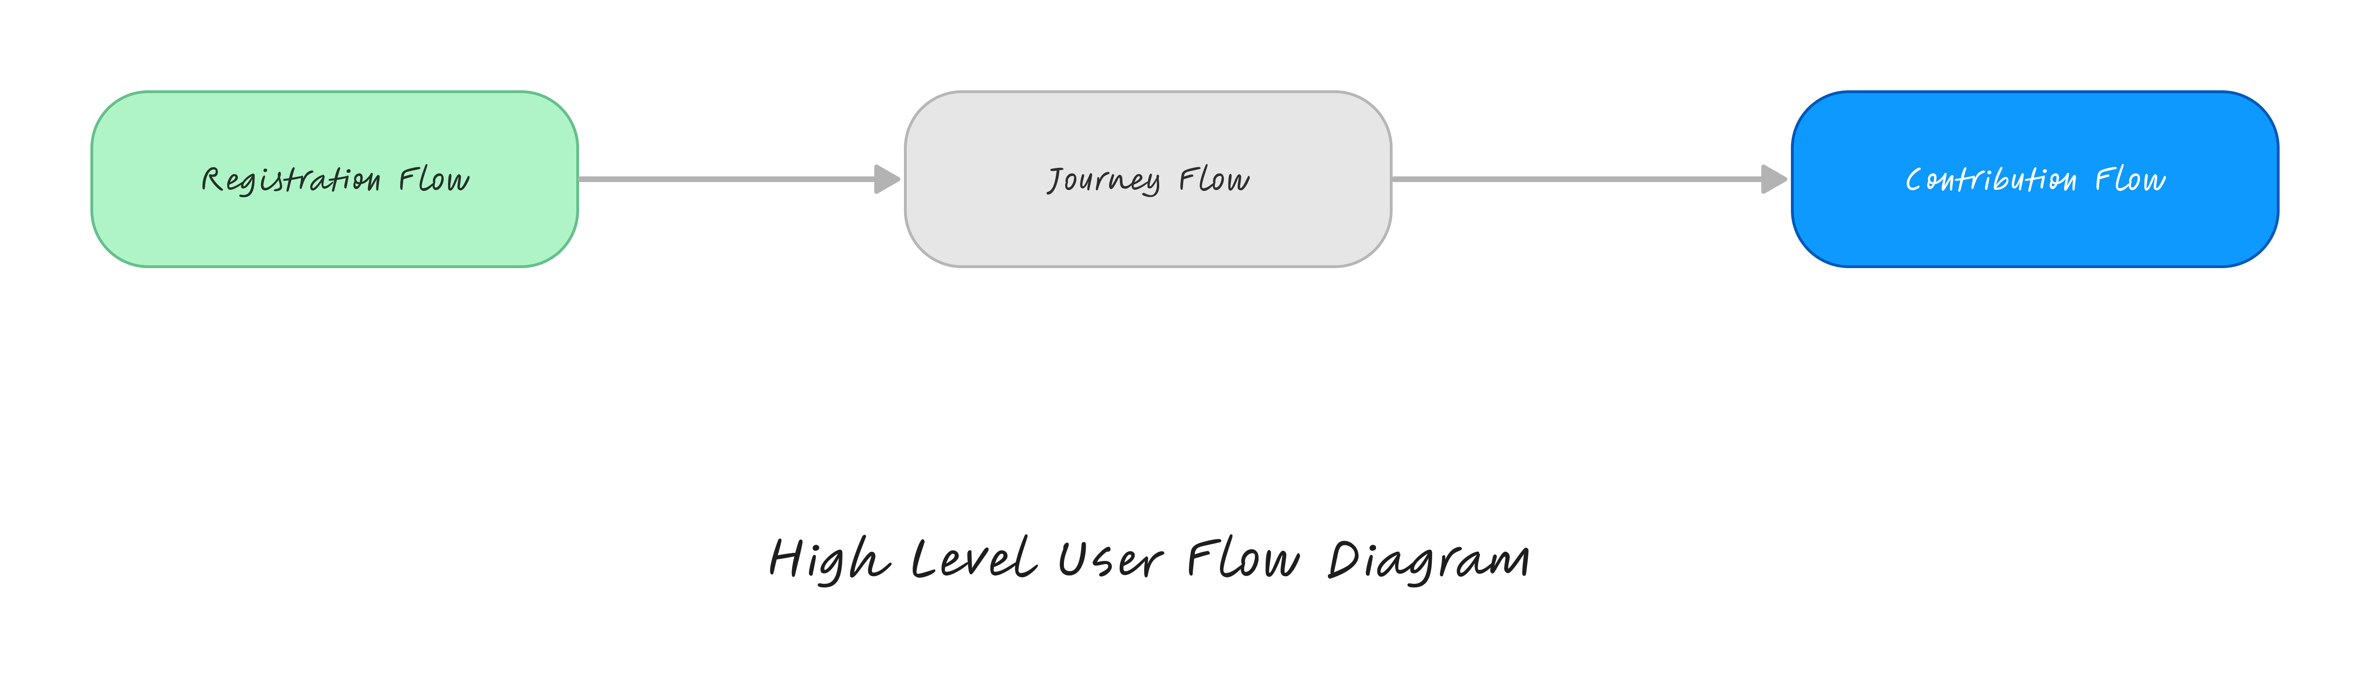

Slide 9
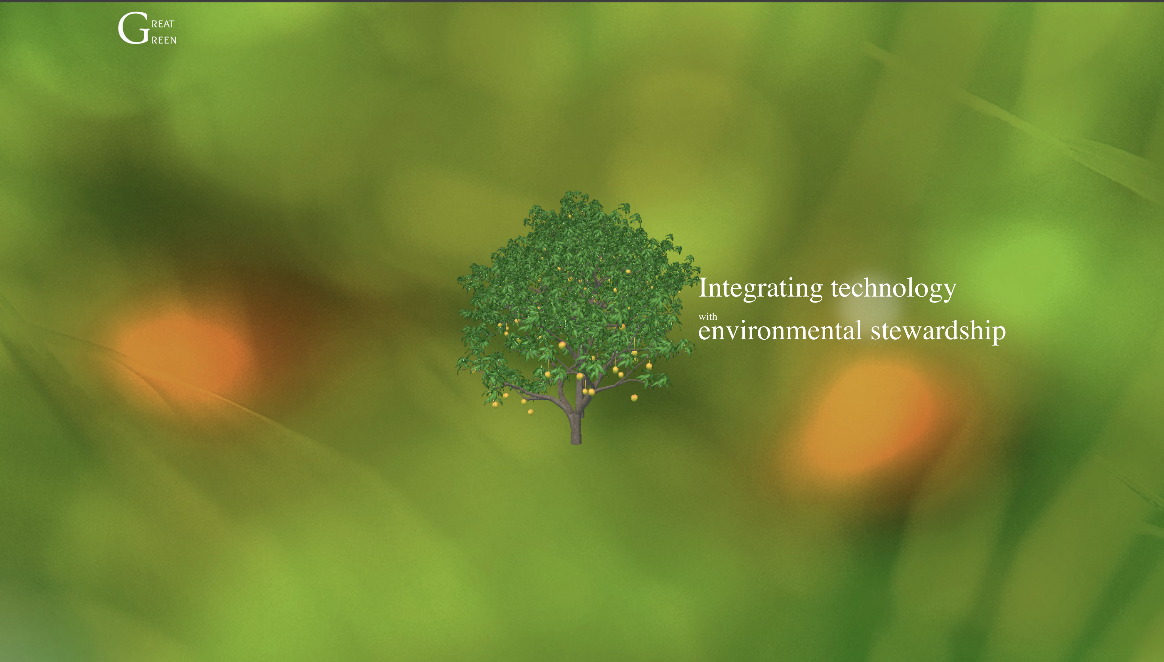
Screenshots of UI
Landing page 3D model integration

Slide 10
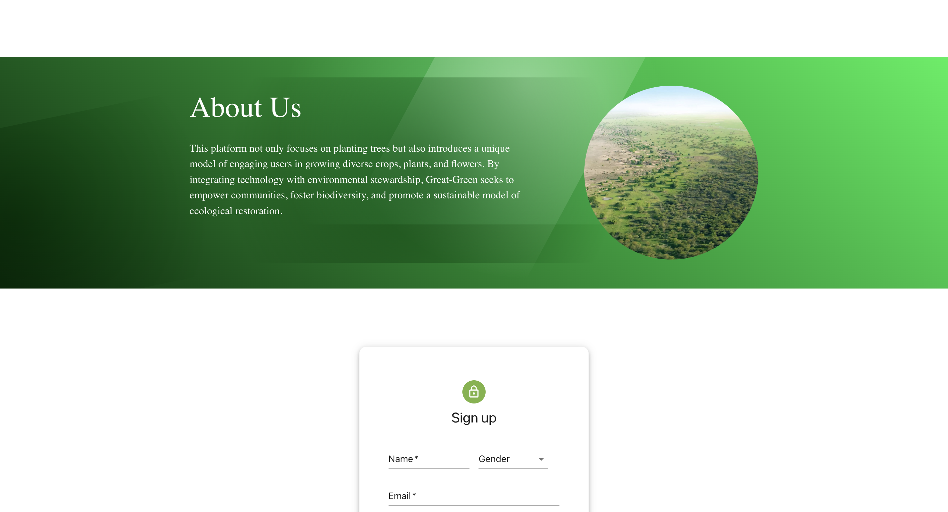
About Us

Slide 11
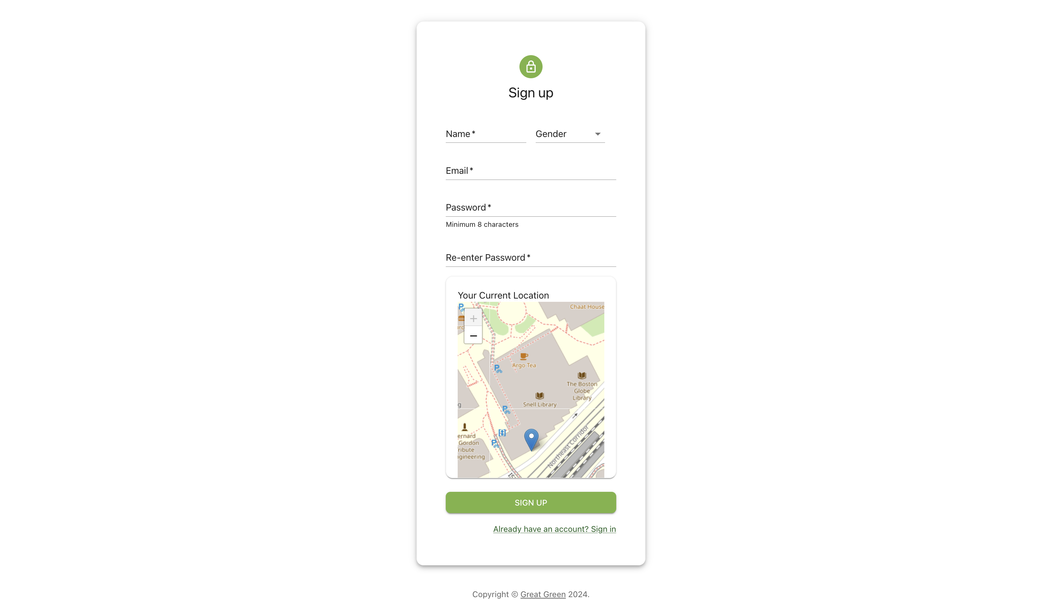
Sign Up page with leaflet map

Slide 12
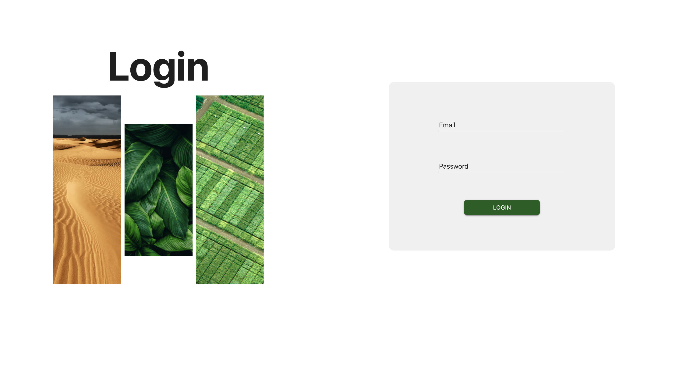
Login page

Slide 13
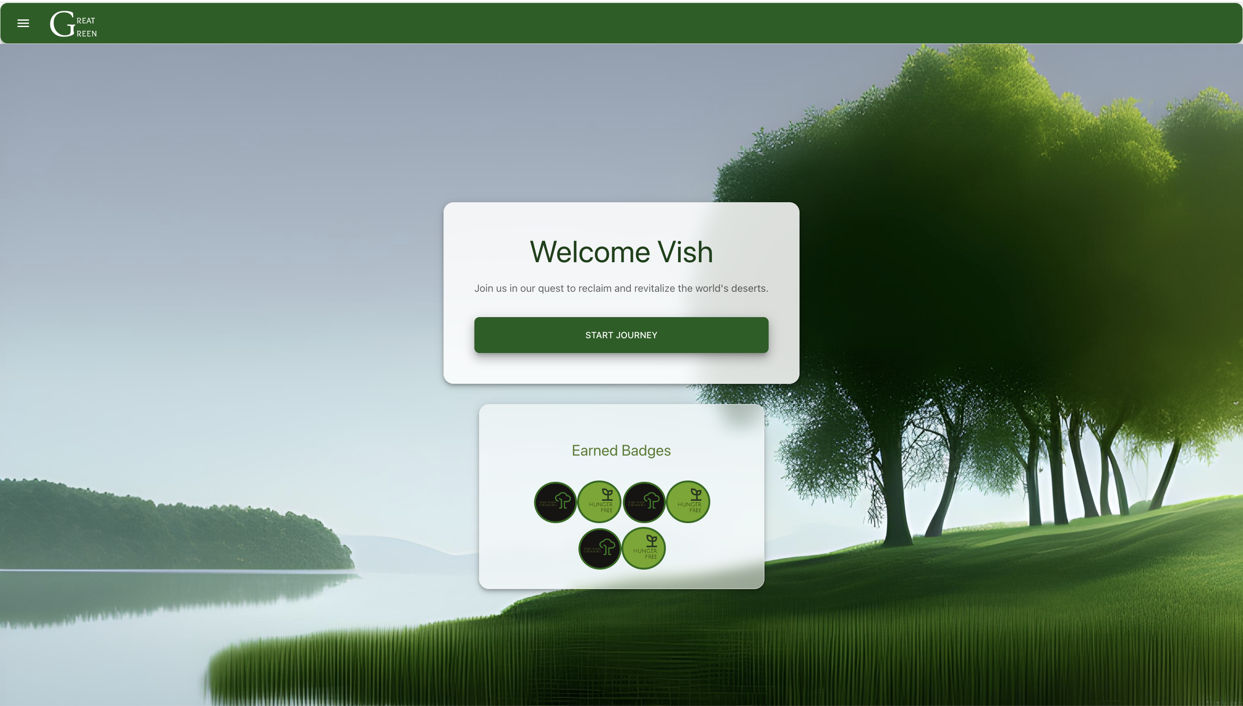
Dashboard of User

Slide 14
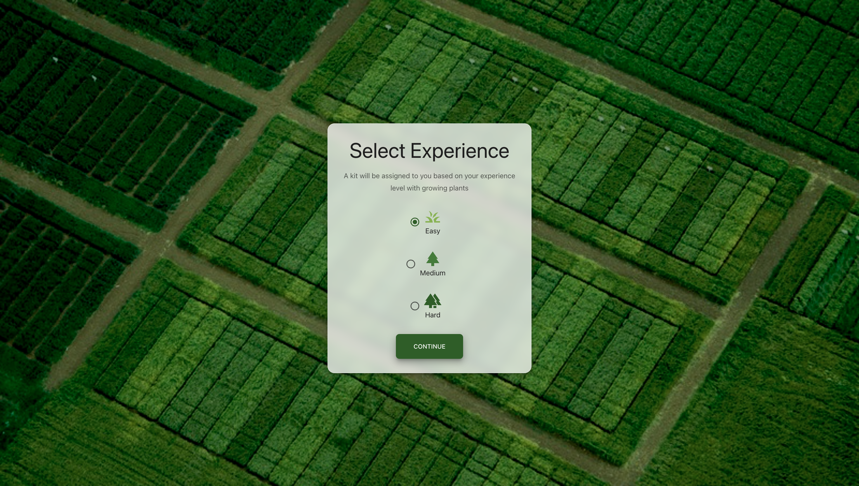
Selecting user experience

Slide 15
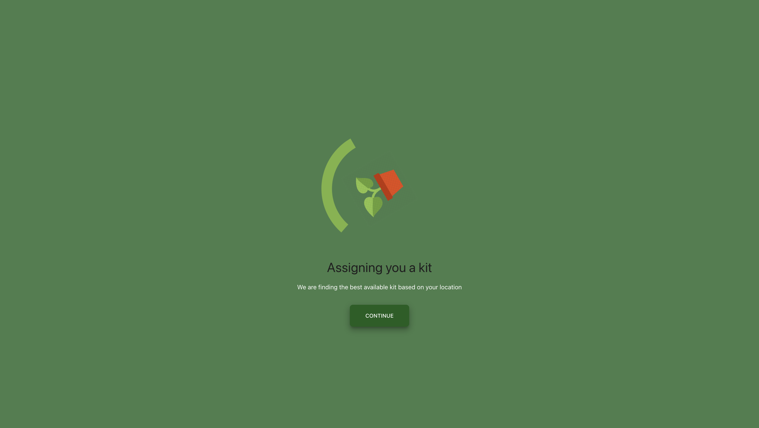
Assigning a kit to user

Slide 16
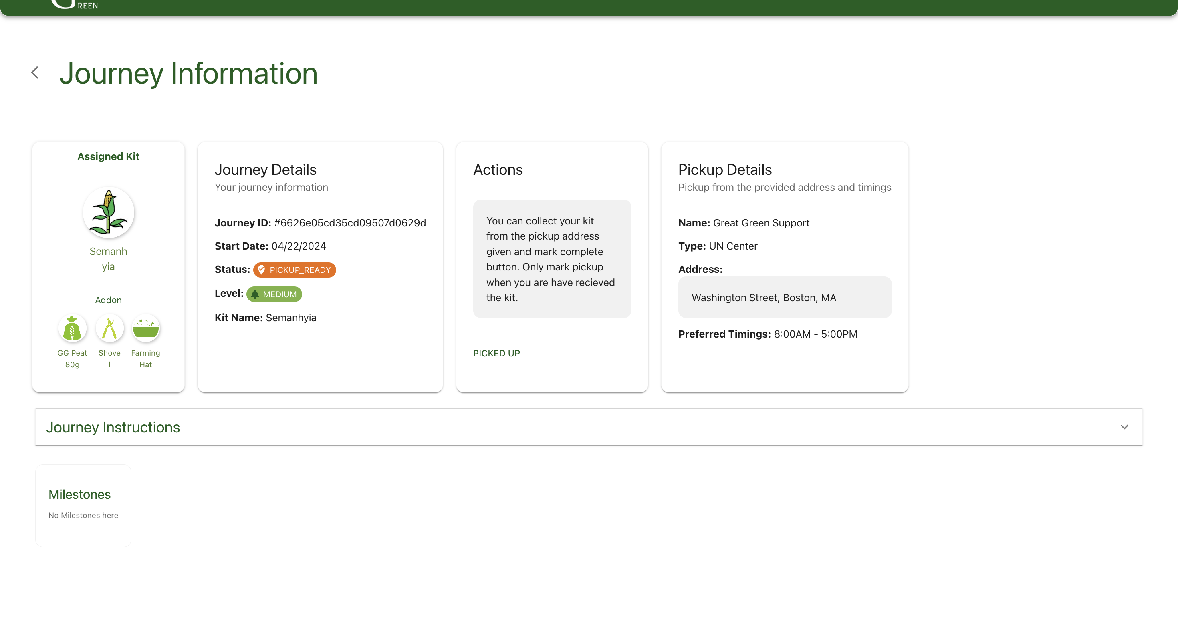
Journey Information

Slide 17
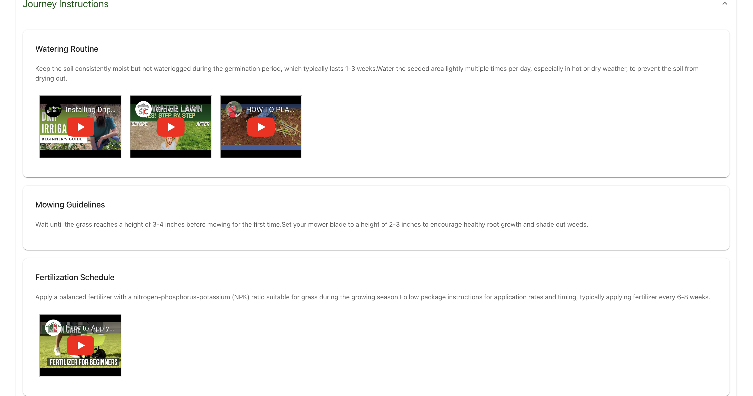
Journey Instructions

Slide 18
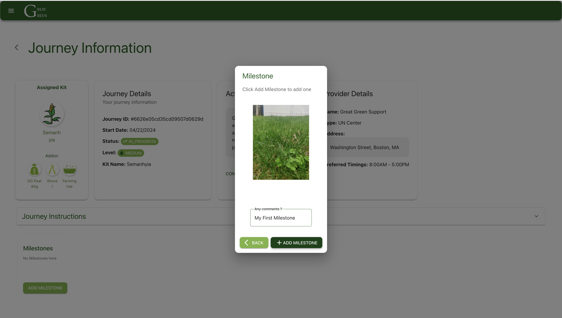
Adding new milestones

Slide 19
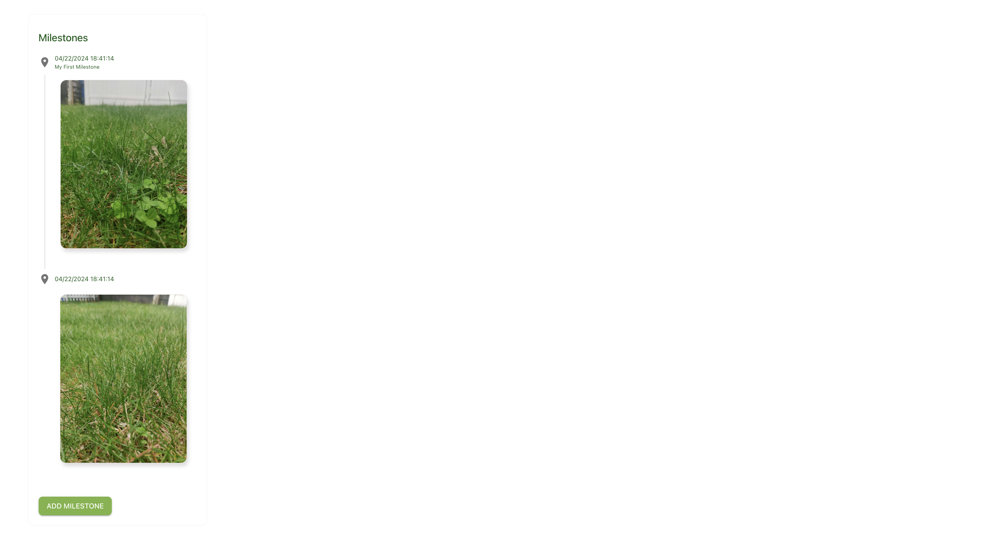
List of milestones

Slide 20
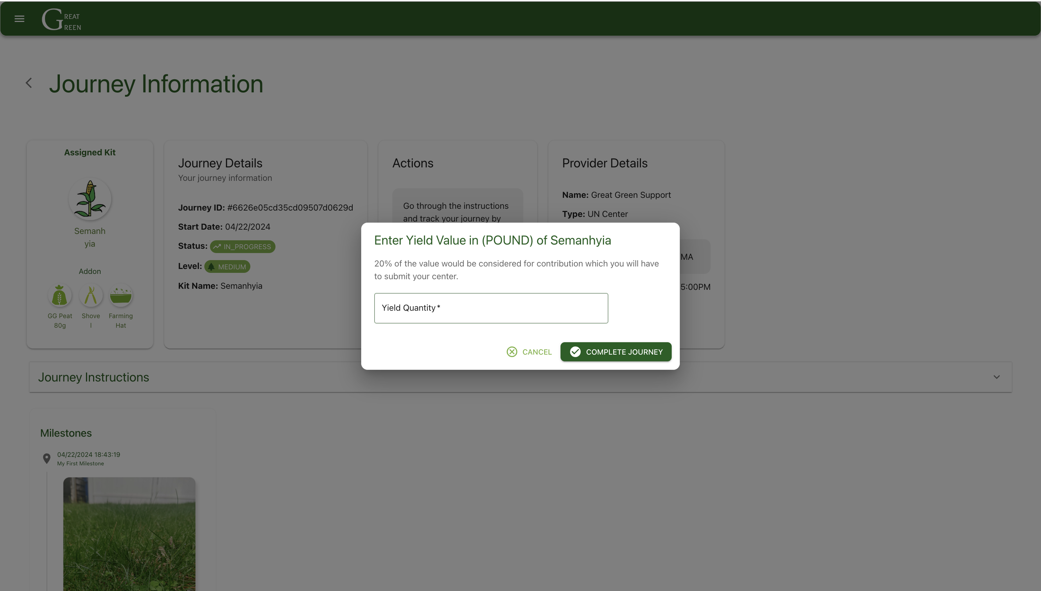
Contribution back to society

Slide 21
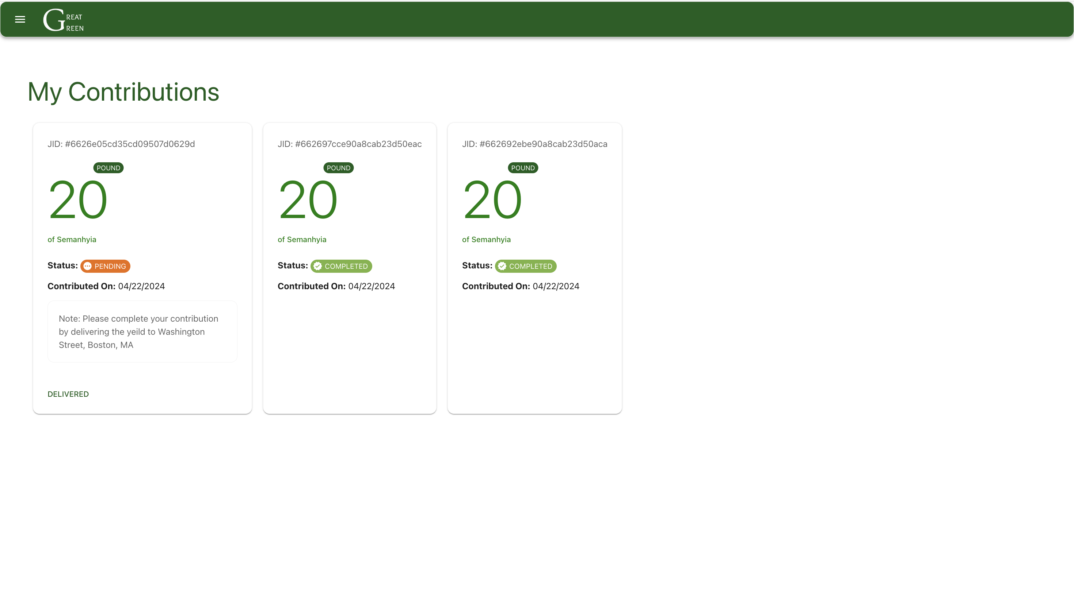
My contributions

Slide 22
Thank you
Great Green
INFO6150
Final Project

